Slide 1

Gender classification from blog text
Hoang Vo – 1671058
COSC 6342
Wednesday, April 21, 2021

Slide 2
Problem Statement and Dataset
Statement: Given a set of labeled blogs written by males and females in English language, predict the gender of the author of a new blog.
Dataset:
Sample blog author dataset used in [Mukherjee and Liu, EMNLP 2010] available from: http://www.cs.uic.edu/~liub/FBS/blog-gender-dataset.rar. The dataset has 2 features: blog content and author gender. The data set consists of 3232 blogs.
Over all, the main issue of my project is overfitting.

Slide 3
Basic steps
Clean Data with numpy and pandas
Process text with nltk package:
lower(),
remove punctuation,
remove stopwords,
Tokenize and Padding
Pre-trained model for weight embeddings
Building CNN model
Training data
Testing

Slide 4
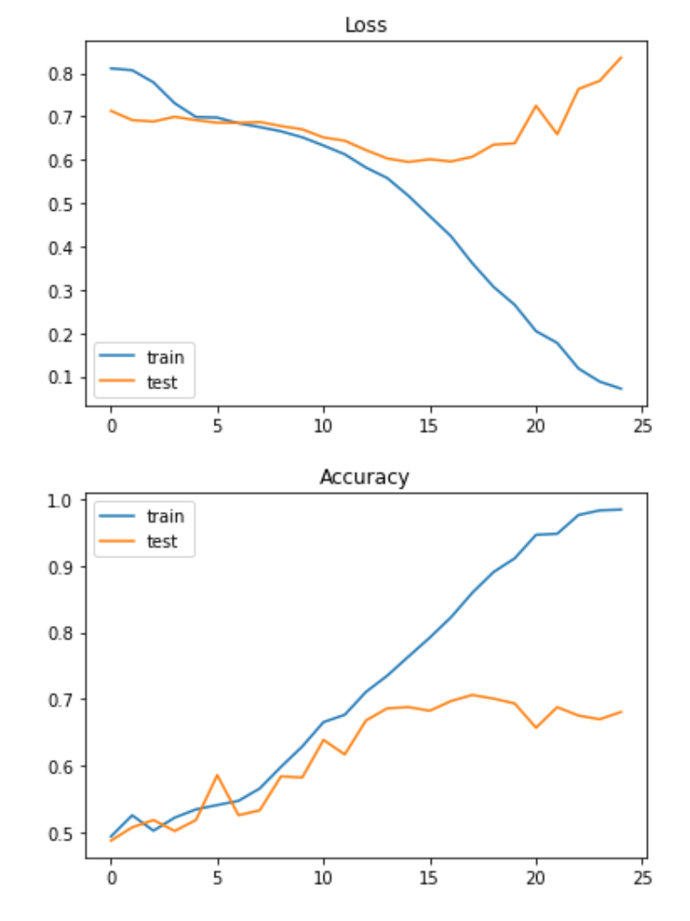
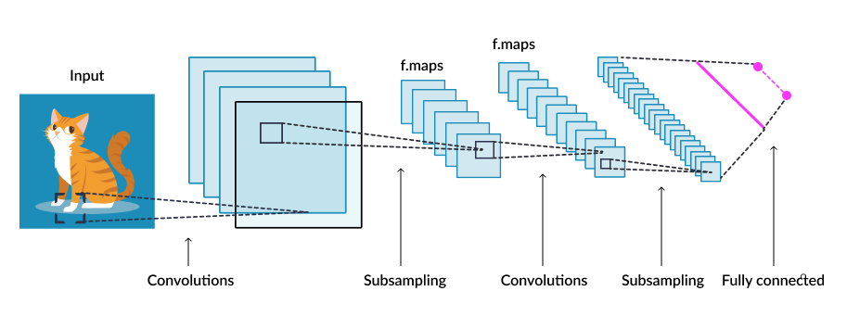
Previous results- CNN training
Learning rate= 0.0001
Optimizer: Adam
Batch size: 64, 128, or 512
Epochs: 20-25 epochs
Model: 7 conv1d+7maxpool-> flatten-> 3 fully connected layers ‘relu’-> 1 last dense layer, output
-> test accuracy = 64.6% - overfitting
Link: https://github.com/Hoangvo92/machineLearningCOSC/blob/main/CNNmethod6.ipynb
Notes:
https://www.skyfilabs.com/project-ideas/image-classifier-for-identifying-cats-dogs

Slide 5
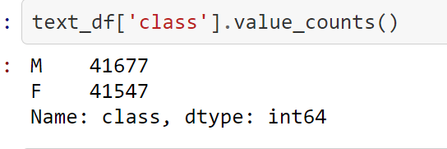
Solving Overfitting
Adding more data:
Blogtext.csv . Having over 681000 blogs. 51% male and 49% female. Link: https://www.kaggle.com/rtatman/blog-authorship-corpus?select=blogtext.csv
Train.json file from Blog posts labeled with age and gender, 2006. Having over 528000 blogs. Link: https://www.kaggle.com/tomlisankie/blog-posts-labeled-with-age-and-gender
I simply combined 2 files into one, shuffled the data, and adding 40000~100000 (50% male ~0% female) new blogs into the original dataset.
-> 83224 text blogs totally (50.1% male and 49.9% female).
Notes:
J. Schler, M. Koppel, S. Argamon and J. Pennebaker (2006). Effects of Age and Gender on Blogging in Proceedings of 2006 AAAI Spring Symposium on Computational Approaches for Analyzing Weblogs.

Slide 6
Solving Overfitting
Pretrained model for embeddings:
Using pretrained Spacy model: en_core_web_lg
Previously, I used these models:
GoogleNew-vectors-negative300.bin.gz
Knowledge-vectors-skipgram1000.bin
Notes:
J. Schler, M. Koppel, S. Argamon and J. Pennebaker (2006). Effects of Age and Gender on Blogging in Proceedings of 2006 AAAI Spring Symposium on Computational Approaches for Analyzing Weblogs.

Slide 7
Solving Overfitting
Adjust CNN model structure for simpler structure
3 conv1D layers with ‘relu’ function: [[300, 7, 3], [300, 7, 3], [300, 3,3]]. Accompanied by pooling layers and dropout (0.5)
Flatten
6 fully-connected dense layers ‘Sigmoid’: [128, 128, 64, 64, 32, 32], sigmoid
Predict-output dense layer ‘softmax’

Slide 8
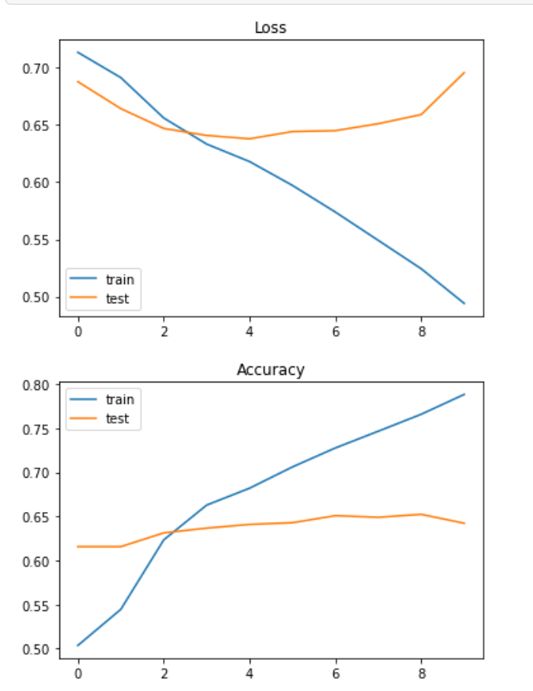
Solving Overfitting
Parameter Selection:
Train-test-split: 0.2
Learning rate: 0.0001
Batch size: 128
Optimizer: RMSprop (or Adam)
Number of epochs: 10

Slide 9
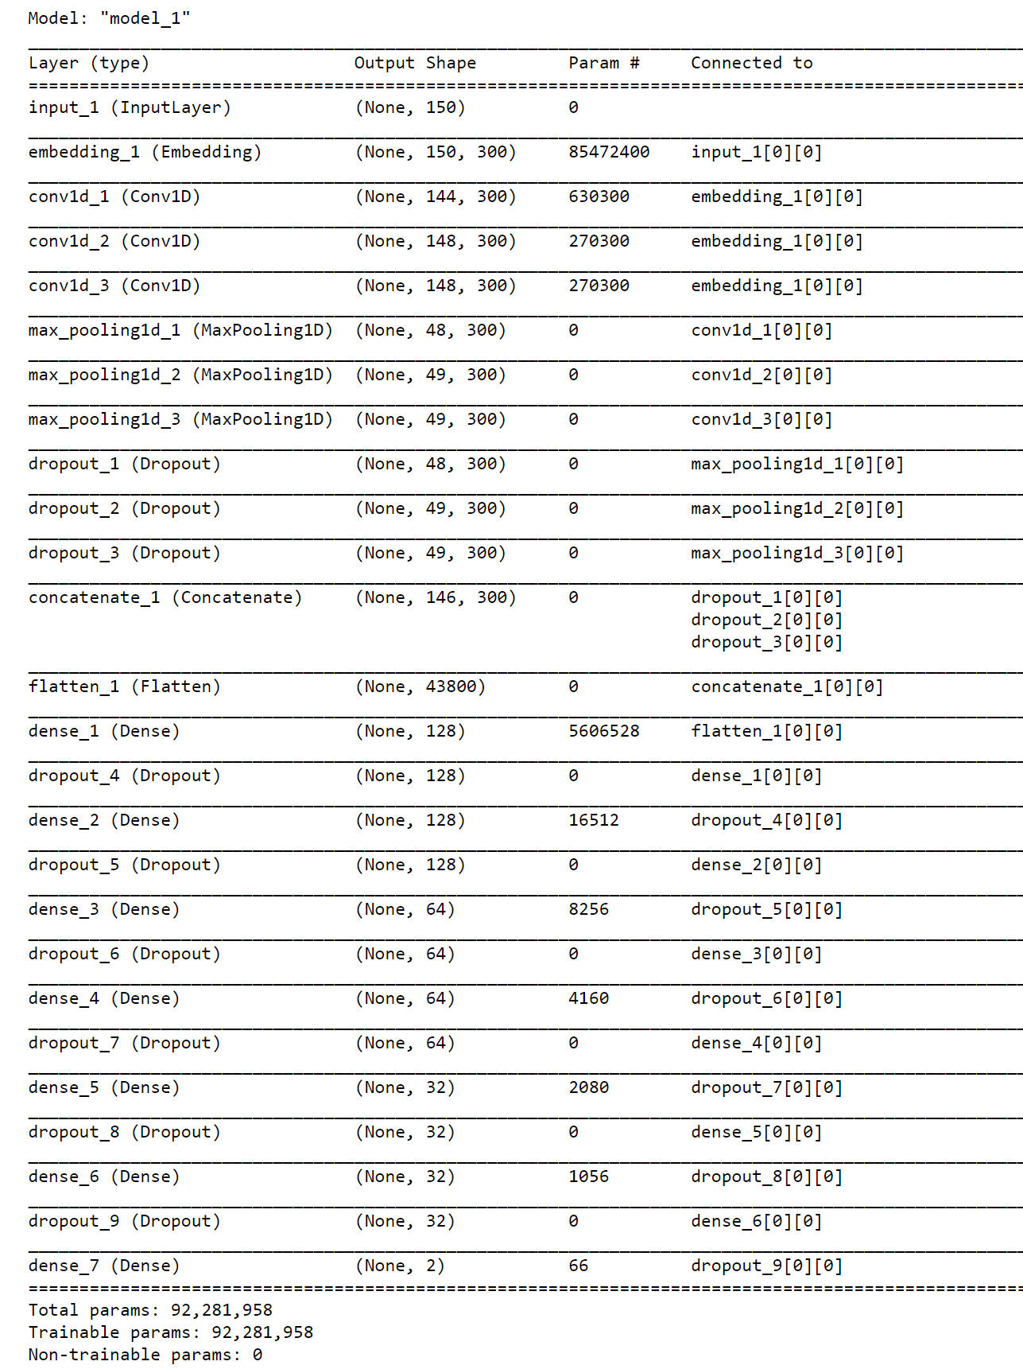
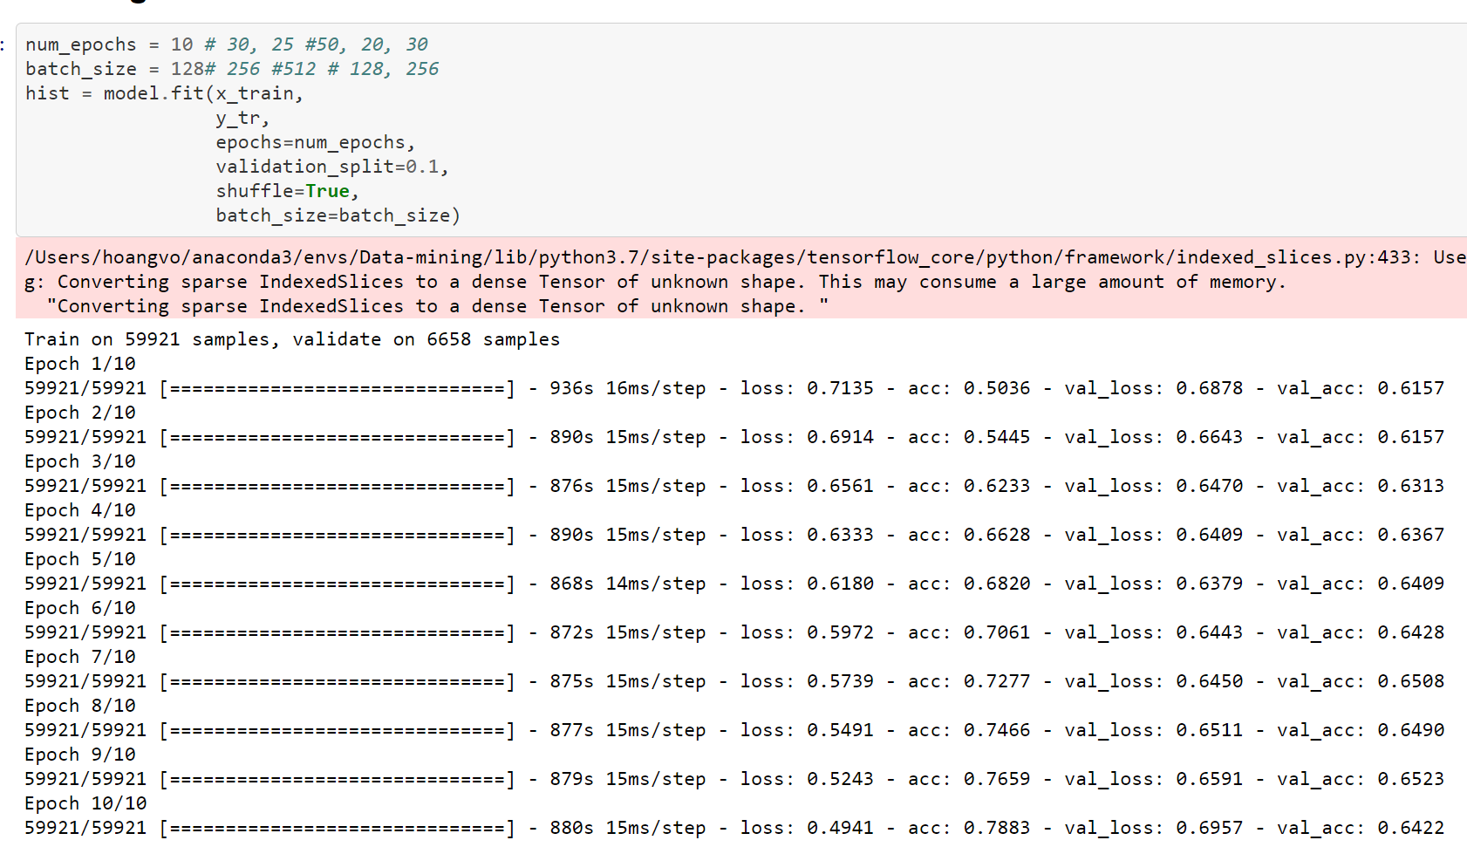

Slide 10
Current Issues
Now much improvement: testing accuracy <70%
Long time of training
Validation accuracy increases to 67% and drops.
Ideas for solutions:
focus on embeddings: TSNE, Glove, and so on
Using LSTM layer inside CNN model

Slide 11
Schedule
Due to unexpected issues of overfitting in testing phrase, my project is being delayed.
4/30: finish report with all available results

Slide 12
Questions and Answers

